Slide 1
San Francisco City Employee Salary DataSet
Real Time Project
by VINEET KUMAR

Slide 2
Dataset Overview: San Francisco Employee Salaries
This dataset provides a detailed breakdown of compensation for public employees working for the City and County of San Francisco. Spanning multiple years, it includes comprehensive pay information such as base salary, overtime, and additional benefits.
Key Features: 13 Columns , 148654 Rows
Unique identifiers for each employee entry, including name, job title, and status
Financial details such as BasePay, OvertimePay, OtherPay, and Benefits
Summarized totals for both total pay and total compensation including benefits
Annual data allowing for year-wise comparison and trend analysis
This dataset serves as a powerful resource for:
Workforce analysis and budgeting Compensation equity assessments
Public sector transparency and accountability
Data science projects
focused on classification, regression, and pattern discovery
Whether you're exploring salary distributions, identifying high-paying roles, or studying pay
trends over time, this dataset provides the foundation for insightful and impactful analysis.

Slide 3
Business Requirement
1
Display Top 10 Rows of The Dataset
2
Check Last 10 Rows of The Dataset
3
Find Shape of Our Dataset (Number of Rows And Number of Columns)
4
Getting Information About Our Dataset Like Total Number Rows, Total Number of
Columns, Datatypes of Each Column And Memory Requirement
5
Check Null Values In The Dataset
6
Drop ID, Notes, Agency, and Status Columns
7
Get Overall Statistics About The Dataframe
8
Find Occurrence of The Employee Names (Top 5)
9
Find The Number of Unique Job Titles
10
Total Number of Job Titles Contain Captain

Slide 4
11
Display All the Employee Names From Fire Department
12
Find Minimum, Maximum, and Average Base Pay
13
Replace 'Not Provided' in Employee Name' Column to NaN
14
Drop The Rows Having 5 Missing Values
15
Find Job Title of ALBERT PARDINI
16
How Much ALBERT PARDINI Make (Include Benefits)?
17
Display Name of The Person Having The Highest Base Pay
18
Find Average Base Pay of All Employee Per Year
19
Find Average Base Pay of All Employee Per Job Title
20
Find Average Base Pay of Employee Having Job Title ACCOUNTANT
21
Find Top 5 Most Common Jobs

Slide 5






We will work with 4 Libraries

Slide 6
Let’s START

Slide 7
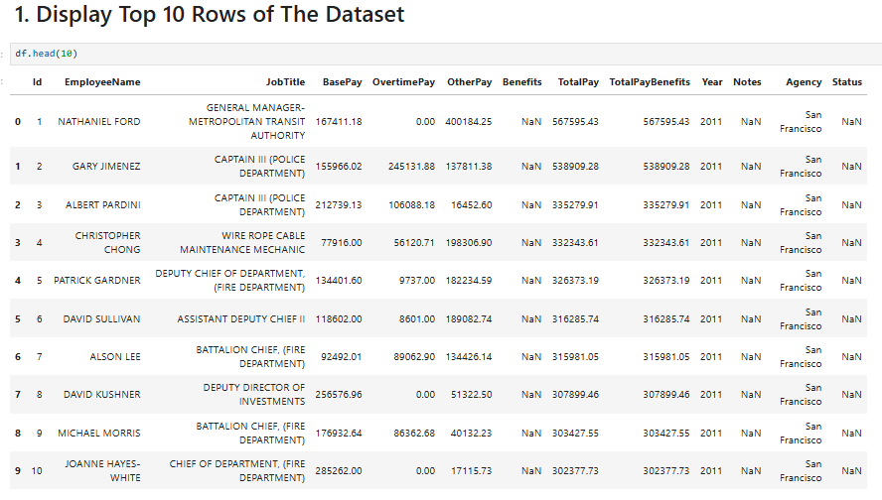

Slide 8
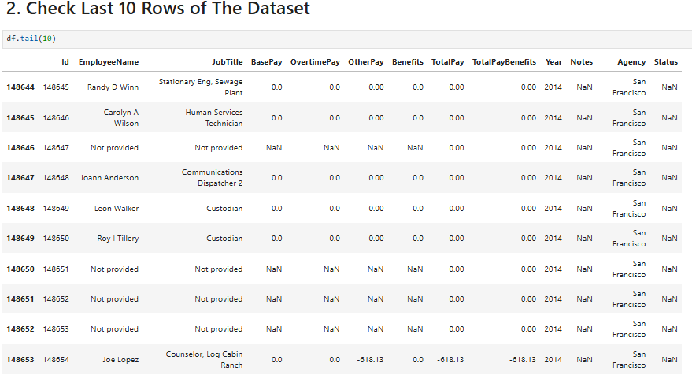

Slide 9
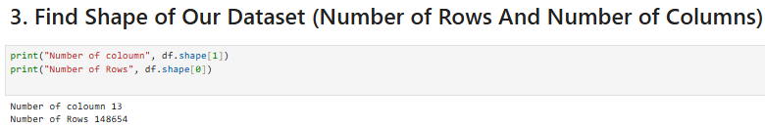

1
2
3
5
4

Slide 10
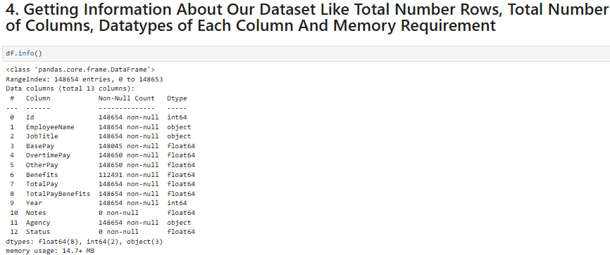
111

Slide 11
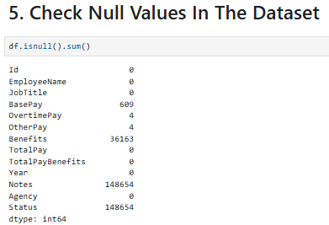
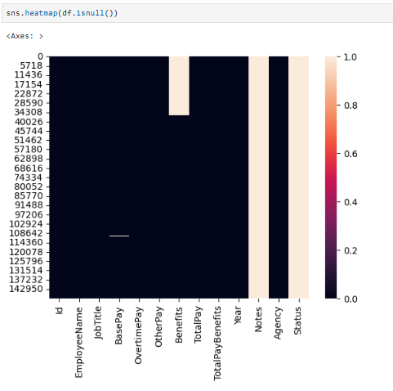


Slide 12
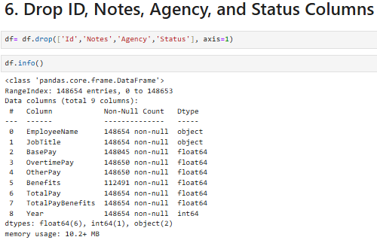


Slide 13
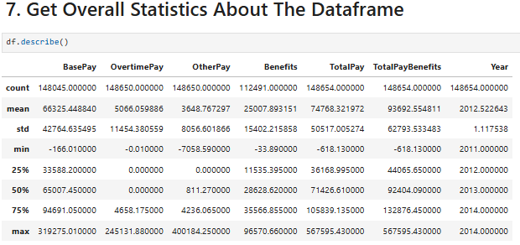


Slide 14
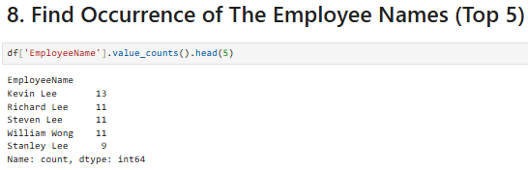



Slide 15
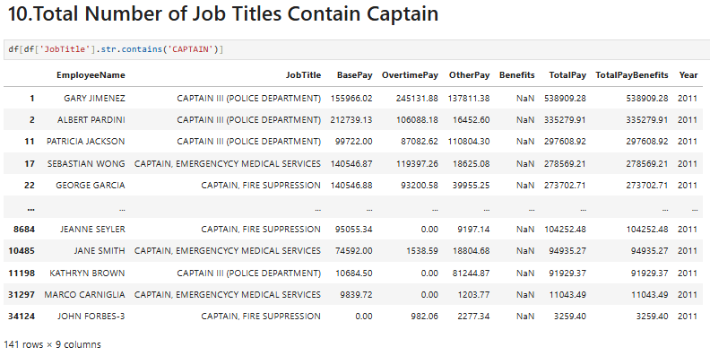

Slide 16
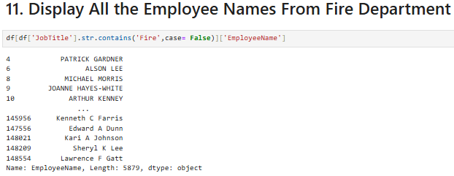

Slide 17
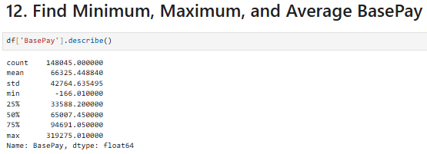


Slide 18
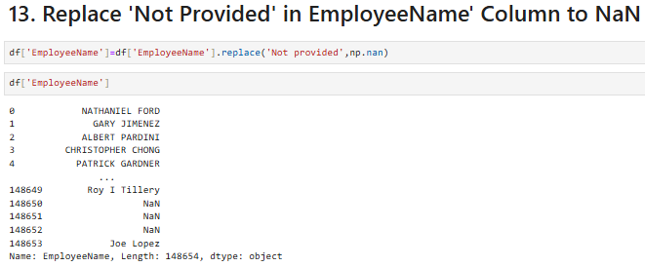

Slide 19
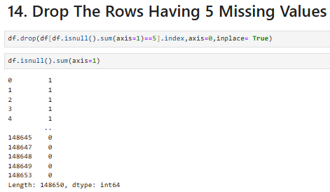

Slide 20
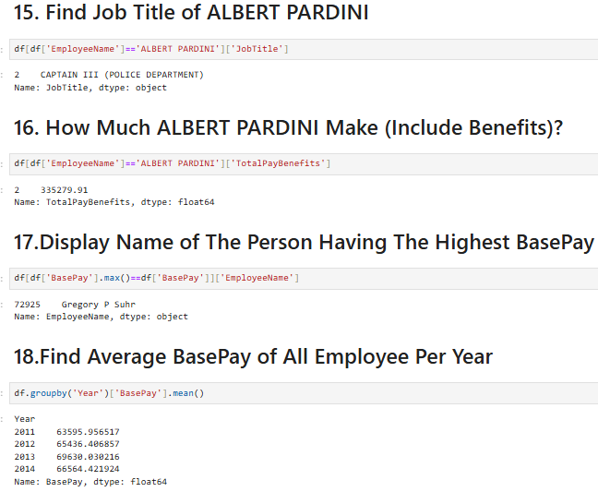

Slide 21
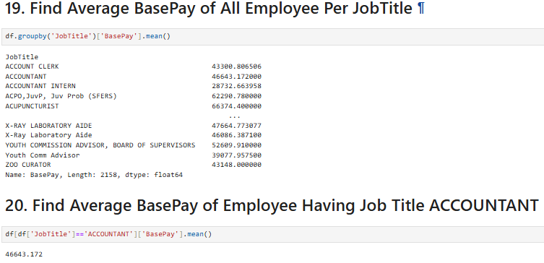


Slide 22
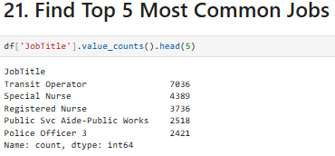

Slide 23

San Francisco Salaries: Beyond the Numbers
Insights. Transparency. Action
Through this analysis, we've uncovered:
Hidden trends in public compensation
Departments with the highest and lowest payouts
The growing cost of overtime and benefits
Opportunities for smarter, data-driven governance

Slide 24

“Data tells the story — it’s up to us to listen, learn, and lead.”
Thank you!
Let’s connect over questions or insights.
vineetkumarji1008@gmail.com

